Slide 1
Brief History of Logic in AI

Slide 2


Logic is not just a historical artifact.
It has been the persistent backbone of AI, evolving to meet new challenges while remaining central to how we build intelligent systems.
“Persistent backbone of AI”
“Persistent backbone”

Slide 3
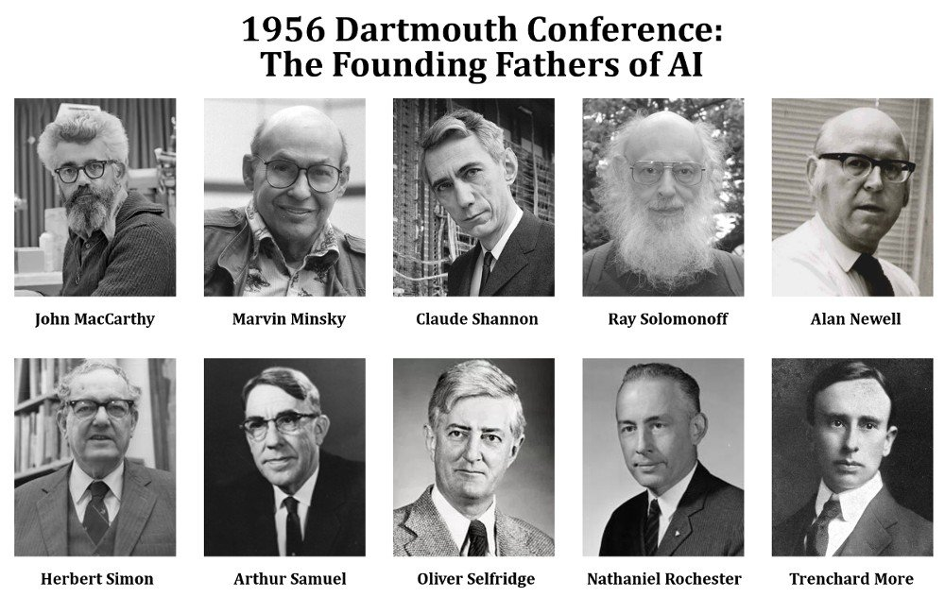
Logic & AI: Historical Context
Dartmouth Conference (Summer 1956)
Established symbolic reasoning as AI's core approach: intelligence through manipulation of logical symbols
Set the "logic can capture thinking" paradigm that dominated AI for 30+ years
Created the research agenda focused on formal reasoning, theorem proving, and rule-based systems
Proposal
"We propose that a 2-month, 10-person study of artificial intelligence be carried out... The study is to proceed on the basis of the conjecture that every aspect of learning or any other feature of intelligence can in principle be so precisely described that a machine can be made to simulate it."

Slide 4
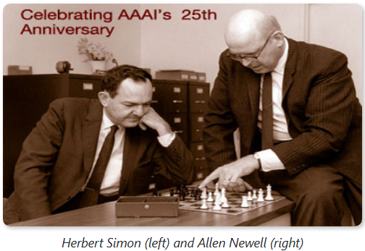
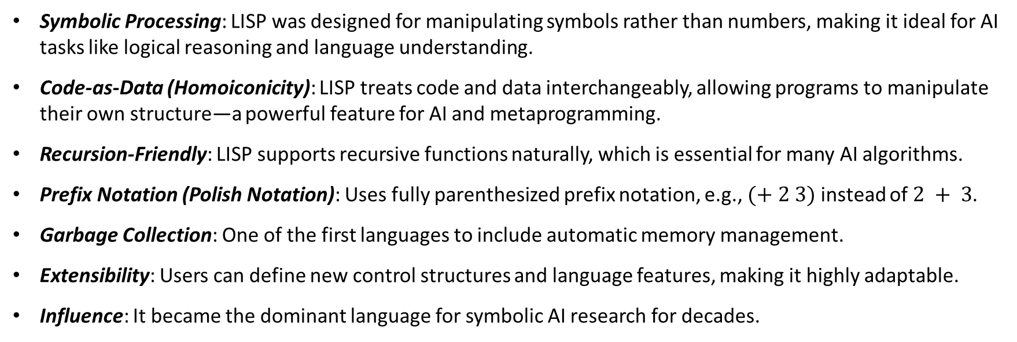
Key Logic-in-AI Milestones I
Logic Theorist (1956) - Newell & Simon
First program to prove mathematical theorems using logical reasoning
Demonstrated that machines could perform formal logical deduction
LISP (“List Processing”) (1958) - John McCarthy
Symbolic Processing: LISP was designed for manipulating symbols rather than numbers, making it ideal for AI tasks like logical reasoning and language understanding.
Code-as-Data (Homoiconicity): LISP treats code and data interchangeably, allowing programs to manipulate their own structure—a powerful feature for AI and metaprogramming.
Recursion-Friendly: LISP supports recursive functions naturally, which is essential for many AI algorithms.
Prefix Notation (Polish Notation): Uses fully parenthesized prefix notation, e.g., $(+ 2 3)$ instead of $2 + 3$.
Garbage Collection: One of the first languages to include automatic memory management.
Extensibility: Users can define new control structures and language features, making it highly adaptable.
Influence: It became the dominant language for symbolic AI research for decades.

Slide 5
Key Logic-in-AI Milestones II
Expert Systems Era (1970s-1980s)
Rule-based systems using “IF-THEN” logical reasoning
Proved logical reasoning could solve real-world problems; established knowledge representation as encoding logical rules; showed logic could capture expert human reasoning
DENDRAL: Stanford (1960s)
Purpose: Assist chemists in identifying molecular structures from mass spectrometry data.
Domain-Specific Expert System: Focused on organic chemistry, particularly structural analysis.
Rule-Based Reasoning: Used encoded chemical knowledge and inference rules to generate hypotheses.
Knowledge Engineering Breakthrough: Pioneered techniques for capturing expert knowledge in a formal system.
Impact: Demonstrated that expert systems could outperform human experts in narrow domains.
MYCIN: Stanford (1970s)
Purpose: Diagnose bacterial infections and recommend antibiotics.
Rule-Based System: Used hundreds of “IF-THEN” rules to simulate expert reasoning.
Knowledge Representation: Encoded medical expertise as logical rules.
Inference Engine: Applied backward chaining to deduce conclusions from symptoms.
Uncertainty Handling: Introduced certainty factors to manage probabilistic reasoning.
Impact: Demonstrated expert-level decision-making in real-world domains like medicine.

Slide 6
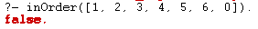
Key Logic-in-AI Milestones III
Logic Programming with Prolog (1970s)
Programming language where you write logical facts and rules, computer ‘searches’ logical conclusions
Made logic itself the programming paradigm: showed computation as logical inference
Influenced AI knowledge representation
naiveSort(L1, L2) :- perm(L1, L2), inOrder(L2).
inOrder([]).
Empty list is ordered.
inOrder([_]).
A list containing 1 element is sorted.
inOrder([A, B | T]) :- A =< B, inOrder([B|T]).
Check if the first two list elements are ordered.
Check that the tail of the original list is ordered.

Slide 7
Key Logic-in-AI Milestones IV
The Logical Reasoning Challenge (1980s Crisis):
Problem: Pure logical systems couldn't handle uncertainty, incomplete information, or common-sense reasoning
Forced development of fuzzy logic and probabilistic reasoning (expanding what “logic” means in AI)
SAT/SMT Solvers (2000s-present)
Extremely efficient programs that solve logical satisfiability problems
Shows logical reasoning can scale to millions of variables; used in software verification, planning, scheduling
SAT: Solving logical boolean formulas
SMT: Boolean logic, but reasoning over integers.
Automated Theorem Proving
AI systems that prove mathematical theorems using formal logic.
Demonstrates machine reasoning can surpass humans in formal domains; verifies critical software and hardware

Slide 8




Two Paradigms: Symbolic vs Connectionist Approaches
We have two fundamentally different philosophies about how intelligence works.
Symbolic (Logic-based)
“Top-Down” Approach: Intelligence through manipulation of symbols and rules
Explicit knowledge representation: We tell the computer what we know
Rule-based reasoning: Follows logical steps humans can trace
Explainable decisions: Can precisely explain “why” it reached a conclusion
Good for structured domains: Excels where rules are clear (chess, theorem proving, legal reasoning)
Core assumption: Intelligence is symbol manipulation
Connectionist (Neural Networks)
“Bottom-Up” Approach: Intelligence emerges from learning patterns
Learning from data: Discovers patterns we might not see
Pattern recognition: Excels at finding subtle statistical regularities
Statistical inference: Makes decisions based on learned associations
Good for perceptual tasks: Handles messy real-world data (vision, speech, language)
Core assumption: Intelligence emerges from interconnected simple units
Reasoning
Learning
cat
Explanation
Adaptation
Integrating paradigms: Neurosymbolic AI
(Recent Trend)

Slide 9
Key Logic-in-AI Milestones V
Neurosymbolic AI (2020s)
Combining neural networks with logical reasoning (e.g., AlphaGeometry)
Merges pattern recognition with logical deduction; represents the future where logic remains essential even in the neural age
LLMs and Logical Reasoning
Large language models showing emergent logical reasoning abilities
Suggests statistical learning can acquire logical structure; raises questions about whether logic is learned or programmed
LRMs (Large Reasoning Models): designed for complex reasoning, combining symbolic logic with neural networks.
Unlike LLMs, they focus on deductive, inductive, and mathematical reasoning
Provide explanations of each step taken facilitating analysis and human verification.

Slide 10
Topics in Logic and Propositional Logic
Introduction to logic
Arguments, validity, soundness, entailment
Propositional logic
Sentences, semantics, inference
Inference methods
Enumeration
Fundamental rules: Modus ponens, modus tollens
Forward chaining (data-driven reasoning)
Backward chaining (goal-driven reasoning)
Resolution (CNF conversion and resolution rule)
Soundness and completeness of inference systems

Slide 11
Arguments
Logic is the study of correct reasoning: how to draw valid conclusions from given information.
Our Challenge: How do we formalize “correct reasoning”?
Before we can automate reasoning, we must understand three key concepts that define what makes reasoning correct.
Definition. An argument is a set of sentences (premises) and a conclusion.
All students must have student IDs to enter the library.
Sarah entered the library.
If you hit the snooze button more than twice, you will be late for your 8am class.
Jake hit the snooze button four times this morning.
Premises
Conclusion
Sarah has a student ID.
Jake will be late for his 8am class.

Slide 12
Validity and Soundness
Definition. An argument is valid if, whenever all its premises are true, the conclusion must be true.
Validity is about the form of the argument—not whether the premises are actually true. Even an argument with false premises can be valid if the conclusion logically follows.
Definition. An argument is sound if it is valid and all premises are actually true.
Sound means the conclusion is not only logically guaranteed but also factually correct.
All smartphones need charging. My phone is a smartphone.
Some students have iPhones. Jessica has an iPhone.
All professors give easy exams.
Dr. Alvin is a professor.
Premises
Conclusion
My phone needs charging.
Jessica is a student.
Dr. Alvin gives easy exams.
Valid?
Valid
No
Valid
Sound?
Sound
No
No

Slide 13


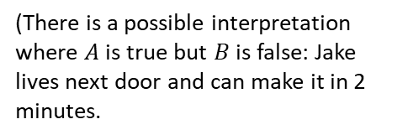
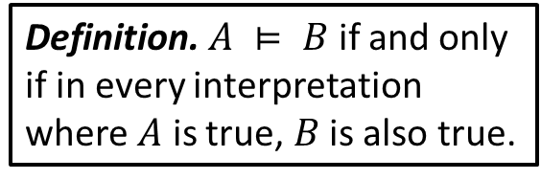
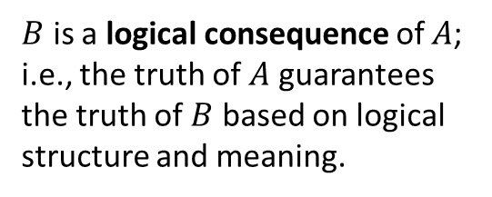
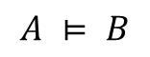
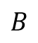

Entailment
Definition. $A ⊨ B$ if and only if in every interpretation where $A$ is true, $B$ is also true.
$B$ is a logical consequence of $A$; i.e., the truth of $A$ guarantees the truth of $B$ based on logical structure and meaning.
$A$ is true
All interpretations
$B$ is true
$$A$$
It is raining heavily.
Jake hit snooze 4 times and his class starts in 10 minutes.
Sarah received an A on every assignment and every quiz/exam in the course.
$$B$$
The ground is wet.
Jake will be late to class.
Sarah will receive an A in the course.
$$A ⊨ B$$
Yes
No
Yes
(Whenever it rains heavily, the ground must be wet.)
(There is a possible interpretation where $A$ is true but $B$ is false: Jake lives next door and can make it in 2 minutes.

Slide 14
Propositional Logic

Slide 15
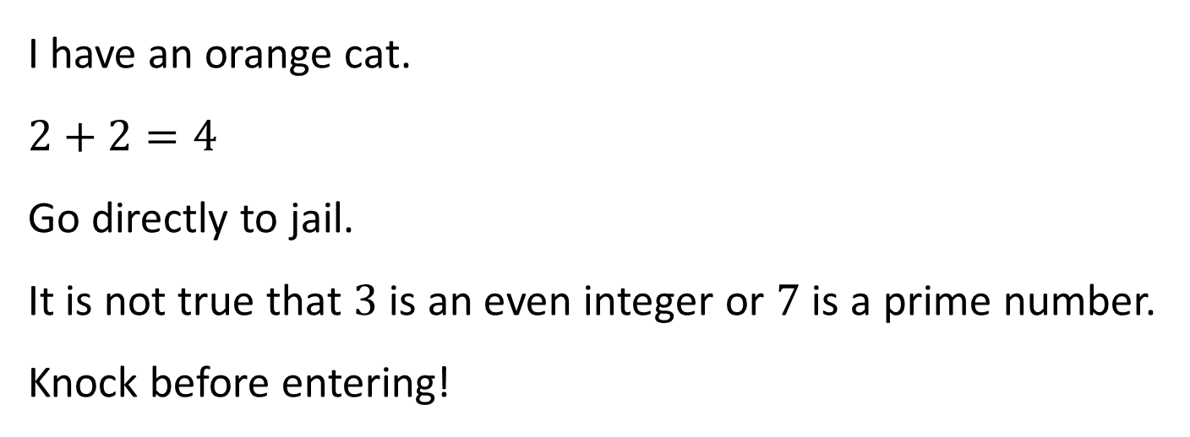
Propositions
Definition. A proposition is a phrase that is either True or False (but not both).
Examples. State whether each phrase is a proposition: yes / no.
I have an orange cat.
$$2+2=4$$
Go directly to jail.
It is not true that $3$ is an even integer or $7$ is a prime number.
Knock before entering!
Yes
Yes
No
Yes
No

Slide 16
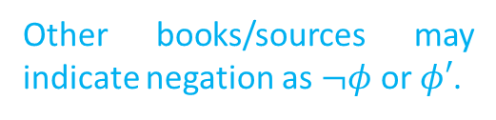
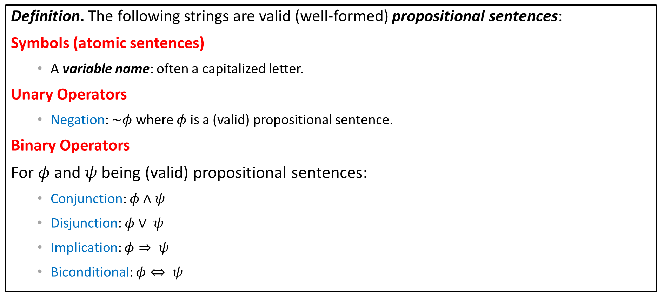
Propositional Formula
Definition. The following strings are valid (well-formed) propositional sentences:
Symbols (atomic sentences)
A variable name: often a capitalized letter.
Unary Operators
Negation: $\sim φ$ where $φ$ is a (valid) propositional sentence.
Binary Operators
For $φ$ and $ψ$ being (valid) propositional sentences:
Conjunction: $φ∧ψ$
Disjunction: $φ∨ ψ$
Implication: $φ⇒ ψ$
Biconditional: $φ⇔ ψ$
Constants
true, false
For example, P, Q, R.
Other books/sources may indicate negation as $¬φ$ or $φ′$.
And
Or
How we formally state an assumption ($φ$) and statement to prove ($ψ$).
How we formally state equivalence.
$φ$: \phi
$ψ$: \psi

Slide 17
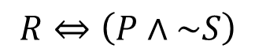
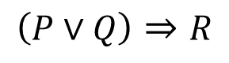

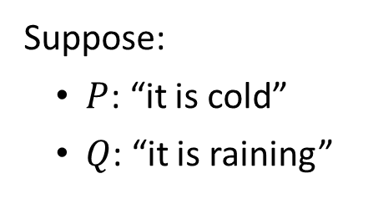

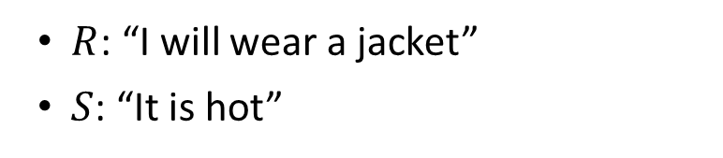
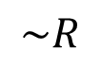
Propositional Sentence Examples
Suppose:
$P$: “it is cold”
$Q$: “it is raining”
$R$: “I will wear a jacket”
$S$: “It is hot”
“I will not wear a jacket.”
$$\sim R$$
“If it is cold, then it is raining.”
$$P⇒Q$$
“If it is raining, then it is cold.”
$$Q⇒P$$
“If it is cold or it is raining, then I will wear a jacket”
$$\left(P∨Q\right)⇒R$$
“I will wear a jacket if and only if it is cold and not hot.”
$$R⇔\left(P∧\sim S\right)$$

Slide 18


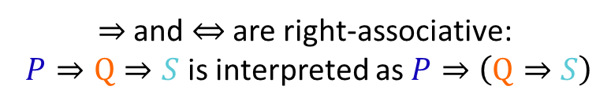

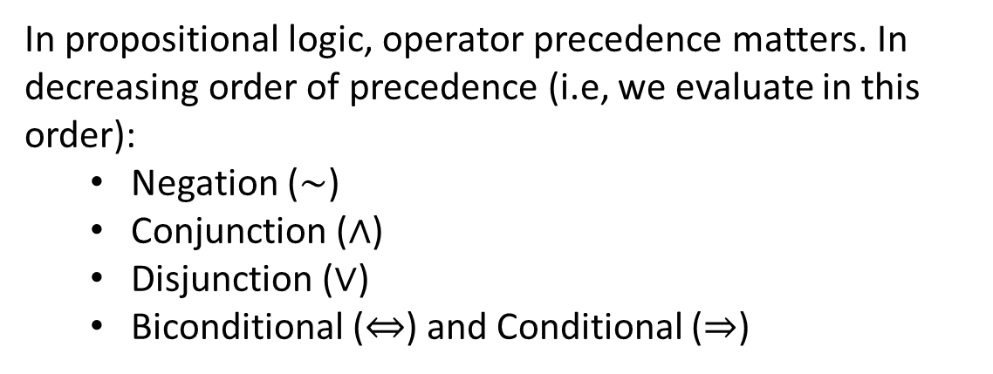









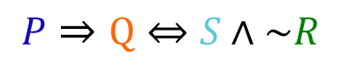










Precedence
In propositional logic, operator precedence matters. In decreasing order of precedence (i.e, we evaluate in this order):
Negation ($\sim$)
Conjunction ($∧$)
Disjunction ($∨$)
Biconditional ($⇔$) and Conditional ($⇒$)
$$P∧Q∨S⇒R$$
$$⇒$$
$$∨$$
$$R$$
$$∧$$
$$S$$
$$P$$
$$Q$$
$$P⇒Q⇒S$$
$$⇒$$
$$⇒$$
Use parentheses to guarantee well-formedness.
$$P$$
$$⇔$$
$$P$$
$$⇒$$
$$Q$$
$$∧$$
$$Q$$
$$S$$
$$\sim$$
$$S$$
$$P⇒Q⇔S∧\sim R$$
$⇒$ and $⇔$ are right-associative:
$P⇒Q⇒S$ is interpreted as $P⇒\left(Q⇒S\right)$
$$R$$

Slide 19
Propositional Logic Semantics

Slide 20


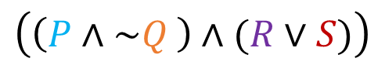


Semantics
All of the previous work helped us establish the syntax of propositional sentences for our language.
Definition. The semantics are the compositional rules that define the meaning of logical connectives and how to evaluate the truth of formulas.
Every variable stands for a primitive proposition that may be either true or false.
Primitive Propositions
We construct compound sentences containing more than one primitive proposition:
$P$ : “It is raining.”
$$\left(\left(P∧\sim Q \right)∧(R∨S)\right)$$
$Q$ : “My umbrella is open.”
This sentence evaluates to true if:
It is raining and my umbrella is not open and
furthermore I am singing or dancing (or both).
$R$ : “I am singing.”
$S$ : “I am dancing.”

Slide 21
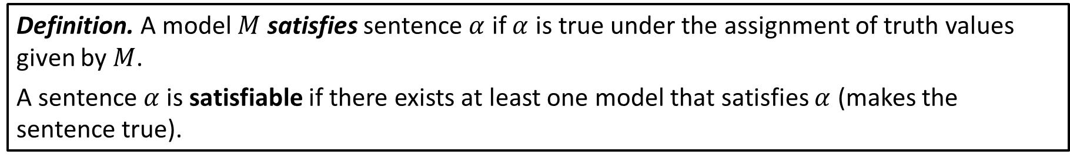


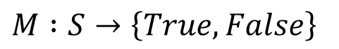
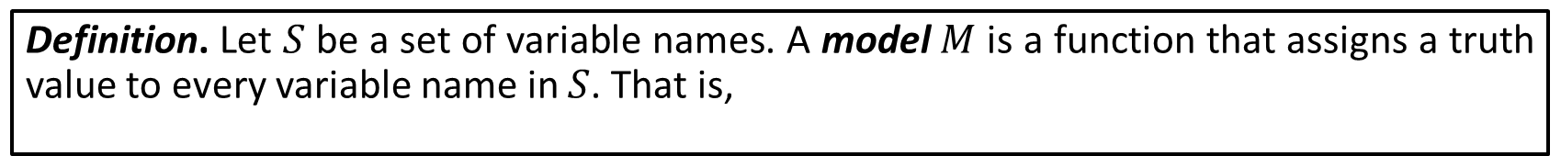
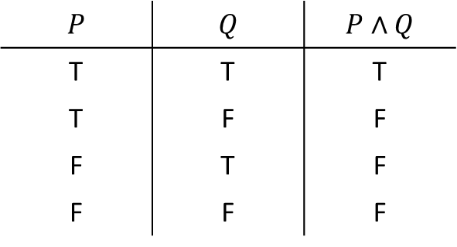
Models
$$P$$ | $$Q$$ | $$P∧Q$$
T | T | T
T | F | F
F | T | F
F | F | F
Let $P∧Q$ be a compound propositional sentence.
Consider configurations of true / false values for primitives $P$ and $Q$.
We call each possible configuration of true and false values for a formula a model.
There are $4$ possible models for $P∧Q$.
Definition. Let $S$ be a set of variable names. A model $M$ is a function that assigns a truth value to every variable name in $S$. That is,
$$M :S→\left\{True, False\right\}$$
Definition. A model $M$ satisfies sentence $α$ if $α$ is true under the assignment of truth values given by $M$.
A sentence $α$ is satisfiable if there exists at least one model that satisfies $α$ (makes the sentence true).

Slide 22












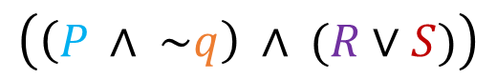








Example
$$∧$$
$$∧$$
$P$ : “It is raining.”
$$∧$$
$$∨$$
$$∧$$
$$∨$$
$Q$ : “My umbrella is open.”
$$P$$
$$\sim$$
$$R$$
$$S$$
$$true$$
$$true$$
$$true$$
$$false$$
$R$ : “I am singing.”
$S$ : “I am dancing.”
$$Q$$
$$M\left(R\right)=true$$
$$∧$$
$$M\left(S\right)=false$$
$$M\left(P\right)=true$$
$$\left(\left(P ∧ \sim q\right) ∧ (R∨S)\right)$$
$$true$$
$$true$$
$$M\left(Q\right)=false$$
It is raining and my umbrella is not open and furthermore I am singing or dancing (or both).
$$true$$
We can say that is sentence is satisfiable. (It may evaluate to true for other models.)

Slide 23
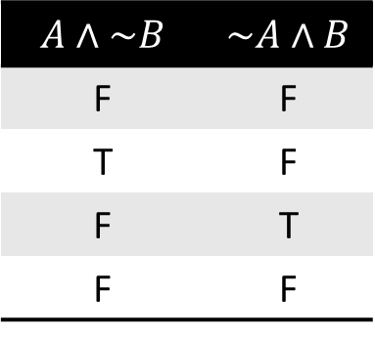
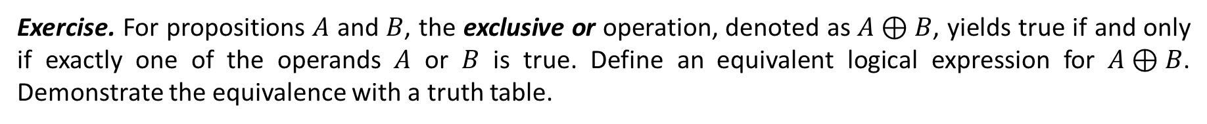
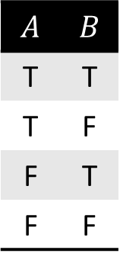
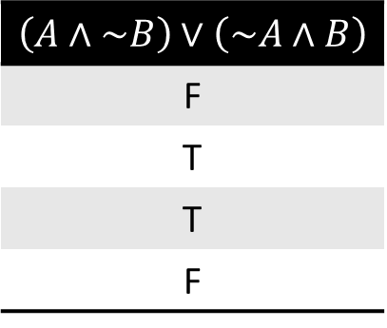
Example: Exclusive Or
Exercise. For propositions $A$ and $B$, the exclusive or operation, denoted as $A⊕B$, yields true if and only if exactly one of the operands $A$ or $B$ is true. Define an equivalent logical expression for $A⊕B$. Demonstrate the equivalence with a truth table.
Solution.
$$A$$ | $$B$$
T | T
T | F
F | T
F | F
$$A∧\sim B$$ | $$\sim A∧B$$
F | F
T | F
F | T
F | F
$$\left(A∧\sim B\right)∨\left(\sim A∧B\right)$$
F
T
T
F

Slide 24
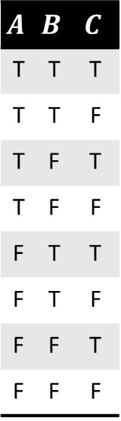
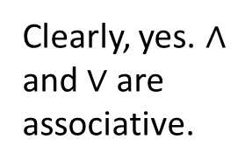
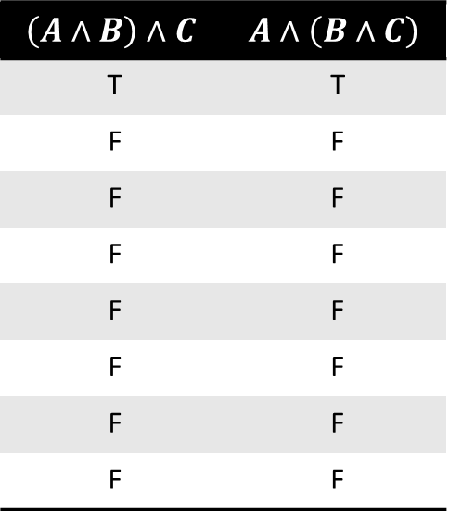
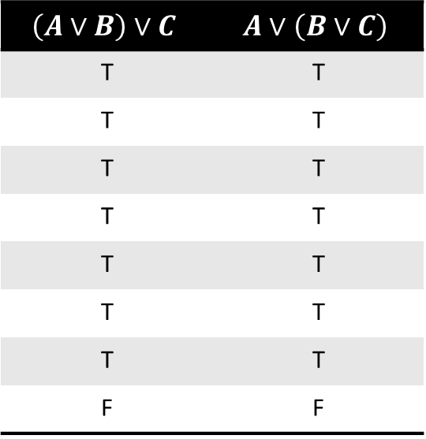
Associativity I
Exercise. For propositions $A,B$ and $C$, are the operators $∨$ and/or $∧$ associative operators?
$\left(A∨B\right)∨C⇔A∨\left(B∨C\right)$ $\left(A∧B\right)∧C⇔A∧\left(B∧C\right)$
Solution.
$$A$$ | $$B$$ | $$C$$
T | T | T
T | T | F
T | F | T
T | F | F
F | T | T
F | T | F
F | F | T
F | F | F
$$\left(A∨B\right)∨C$$ | $$A∨\left(B∨C\right)$$
T | T
T | T
T | T
T | T
T | T
T | T
T | T
F | F
$$\left(A∧B\right)∧C$$ | $$A∧\left(B∧C\right)$$
T | T
F | F
F | F
F | F
F | F
F | F
F | F
F | F
Clearly, yes. $∧$ and $∨$ are associative.

Slide 25
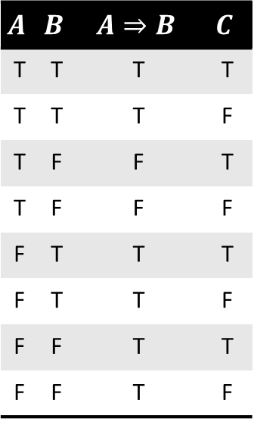


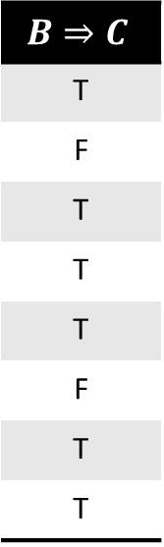
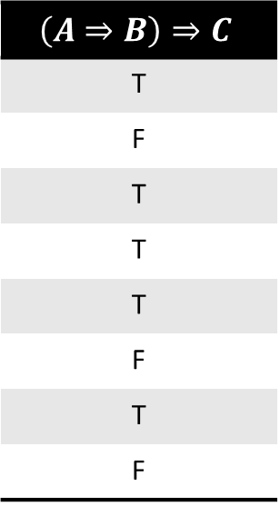
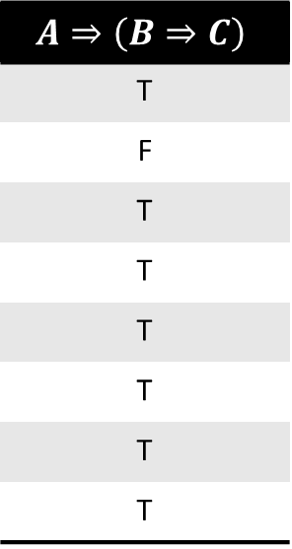
Associativity II
Exercise. Is $⇒$ an associative operator?
Solution.
$$A$$ | $$B$$ | $$A⇒B$$ | $$C$$
T | T | T | T
T | T | T | F
T | F | F | T
T | F | F | F
F | T | T | T
F | T | T | F
F | F | T | T
F | F | T | F
$$\left(A⇒B\right)⇒C$$
T
F
T
T
T
F
T
F
$$B⇒C$$
T
F
T
T
T
F
T
T
$$A⇒\left(B⇒C\right)$$
T
F
T
T
T
T
T
T
$⇒$ is not associative.

Slide 26
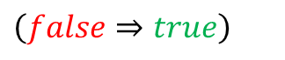
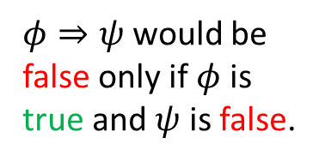
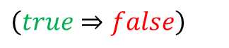
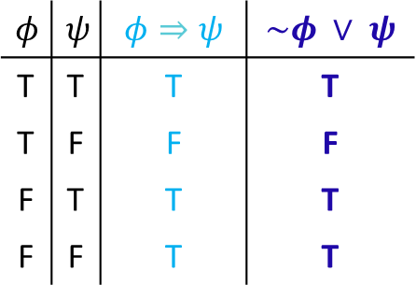
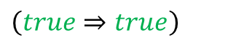
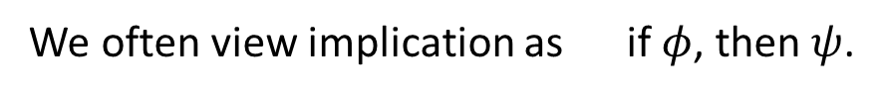
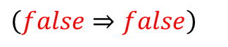
$φ$: \phi
Implication
$ψ$: \psi
$$φ$$ | $$ψ$$ | $$φ⇒ψ$$ | $$\sim φ ∨ ψ$$
T | T | T | T
T | F | F | F
F | T | T | T
F | F | T | T
A helpful interpretation $φ⇒ψ$ is “$ψ$ is a logical consequence of $φ$”.
We often view implication as if $φ$, then $ψ$.
Example.
Suppose I make a promise that, “If I am healthy, I will go to class.”
In each scenario do I keep my promise?
Did I keep my promise?
1. I am healthy, and I do go to class.
$\left(true⇒true\right)$
Yes.
$φ⇒ψ$ would be false only if $φ$ is true and $ψ$ is false.
2. I am healthy, and I do not go to class.
$\left(true⇒false\right)$
No.
3. I am not healthy, and I do go to class.
$\left(false⇒true\right)$
Yes.
4. I am not healthy, and I do not go to class.
$\left(false⇒false\right)$
Yes.

Slide 27
Inference

Slide 28
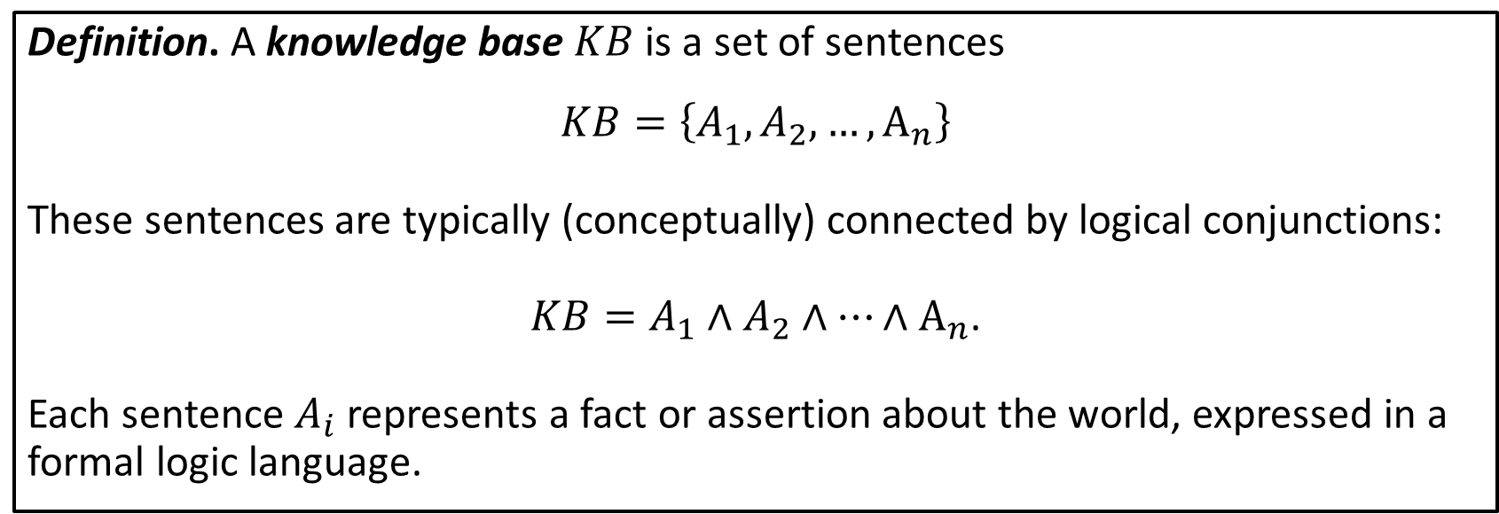
Knowledge Bases
How can an AI agent store, organize, and reason with everything it knows about the world?
Definition. A knowledge base $KB$ is a set of sentences
$$KB=\left\{A_{1},A_{2},…, A_{n}\right\}$$
These sentences are typically (conceptually) connected by logical conjunctions:
$KB=A_{1}∧A_{2}∧…∧A_{n}$.
Each sentence $A_{i}$​ represents a fact or assertion about the world, expressed in a formal logic language.

Slide 29
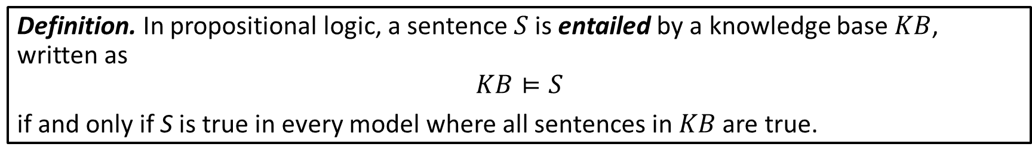
Knowledge Base Entailment and Inference
Entailment tells us what must be true given the facts and rules in the $KB$; it is the foundation for logical reasoning in AI systems.
Definition. In propositional logic, a sentence $S$ is entailed by a knowledge base $KB$, written as
$$KB⊨S$$
if and only if S is true in every model where all sentences in $KB$ are true.
But, what else can we conclude from our $KB$?
Ultimately, our goal is to infer (discover) new sentences that logically follow from a knowledge base.

Slide 30


Knowledge Base Operations
Add new knowledge
TELL($KB$, sentence)
Retrieve entailed information
ASK($KB$, query)

Slide 31
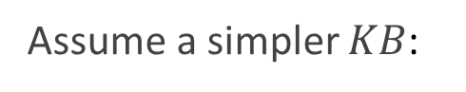
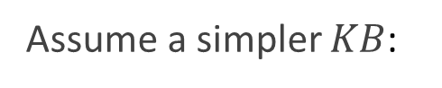

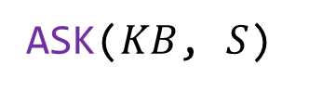










Knowledge Base Operations: Example
Suppose
$$KB=\{$$
P: Alex is a student,
S: Alex needs a textbook
Q: Alex is enrolled in CSC-343
$$\}$$
In propositional logic notation, we have
$$KB=\left\{P∧Q∧S\right\}$$
TELL($KB$, If Alex is enrolled in CSC-343, then Alex needs a textbook)
results in
$$KB=\left\{P∧Q∧S∧\left(Q⇒S\right)\right\}$$
Assume a simpler $KB$:
$$KB=\left\{P∧Q∧\left(Q⇒S\right)\right\}$$
ASK($KB$, $S$)
$$=$$
true
$$KB⊨S$$
Assume a simpler $KB$:
$$KB=\left\{P∧Q∧S\right\}$$
(Maybe Alex needs a textbook for another course.)
ASK($KB$, $Q⇒S$)
$$=$$
false
$$KB⊭Q⇒S$$

Slide 32

Inference
Inference is the process of deriving new sentences that are entailed by a $KB$. Fundamentally, it allows us to answer queries, make decisions, and automate reasoning.
Definition. Inference is the process of deriving a sentence $S$ from a knowledge base $KB$, written as
$$KB⊢S$$
if and only if there exists a way for S to be derived from $KB$ using a sound inference procedure*.
*we will talk about this
From our prior example with $KB=\left\{P∧Q∧\left(Q⇒S\right)\right\}$, we can say $KB⊢S$.
Given a knowledge base (KB), we want to derive new sentences that logically follow without checking every possible truth assignment (aka brute-force model checking).

Slide 33








Methods of Inference: Enumeration
Enumeration is an inference procedure that checks whether a sentence is entailed by a knowledge base by evaluating all possible truth assignments to the propositional symbols.
Suppose $KB=\left\{P∧Q∧\left(P⇒S\right)\right\}$ and ASK($KB$, $S$).
$KB⊢S$ ?
$$P$$ | $$Q$$ | $$S$$
T | T | T
T | T | F
T | F | T
T | F | F
F | T | T
F | T | F
F | F | T
F | F | F
$$P⇒S$$
T
F
T
F
T
T
T
T
$$KB=\left\{P∧Q∧\left(P⇒S\right)\right\}$$
T
F
F
F
F
F
F
F
Yes.
There exists a way to derive
$S$ from $KB$.
$KB⊨S$ ?
Yes.
Recall $KB⊨S$ if and only if in every model where $KB$ is true, $S$ is also true.
Enumeration is an intractable procedure. Why?
$2^{n}$ models for $n$ variables.

Slide 34












Methods of Inference: Syntactic Manipulation
Inference rules provide precise, efficient steps for deriving conclusions: offering clarity and control (explainability) compared to broader procedures like enumeration or resolution, which are more exhaustive but less intuitive.
Modus Ponens
And-Elimination
DeMorgan’s Laws
$$A⇒B, A$$
$$⊢B$$
$$A∧B$$
$$⊢A, B$$
$$\sim \left(A∧B\right)≡\sim \left(A\right)∨\sim \left(B\right)$$
Premise 1:
$$A⇒B$$
Premise 1:
$$A∧B$$
$$\sim \left(A∨B\right)≡\sim \left(A\right)∧\sim \left(B\right)$$
Premise 2:
$$A$$
Conclusion 1:
$$A$$
Conclusion:
$$B$$
Conclusion 2:
$$B$$
There are many others.

Slide 35












Logical Inference Example
Example.
$$\sim \left(P∨Q\right)≡\sim P∧\sim Q$$
DeMorgan’s
Premises:
$$\sim \left(P∨Q\right)$$
$$⇒\sim P∧\sim Q$$
$$\sim P⇒R$$
$$R⇒S$$
$$\sim P∧\sim Q$$
And-Elimination
$$⇒\sim P$$
$$⇒\sim Q$$
$$\sim P,\sim P⇒R$$
Modus Ponens
$$⇒R$$
$$R,R⇒S$$
Modus Ponens
$$⇒S$$

Slide 36

Other Rules of Logical Inference
Rule | Equivalence
Commutativity of $∧$ | $$\left(α∧β\right)≡\left(β∧α\right)$$
Commutativity of $∨$ | $$\left(α∨β\right)≡\left(β∨α\right)$$
Associativity of $∧$ | $$\left(α∧β\right)∧γ≡α∧\left(β∧γ\right)$$
Associativity of $∨$ | $$\left(α∨β\right)∨γ≡α∨\left(β∨γ\right)$$
Double-Negation Elimination | $$\sim \left(\sim α\right)≡α$$
Contraposition | $$\left(α⇒β\right)≡\left(\sim β⇒α\right)$$
Implication Elimination | $$\left(α⇒β\right)≡\left(\sim α∨β\right)$$
Biconditional Elimination | $$\left(α⇔β\right)≡\left(α⇒β\right)∧\left(β⇒α\right)$$
DeMorgan | $$\sim \left(α∧β\right)≡\left(\sim α∨\sim β\right)$$
DeMorgan | $$\sim \left(α∨β\right)≡\left(\sim α∧\sim β\right)$$
Distributivity of $∨$ over $∧$ | $$\left(α∧\left(β∨γ\right)\right)≡\left(\left(α∧β\right)∨\left(α∧γ\right)\right)$$
Distributivity of $∧$ over $∨$ | $$\left(α∨\left(β∧γ\right)\right)≡\left(\left(α∨β\right)∧\left(α∨γ\right)\right)$$
Absorption | $$\left(α∧\left(α∨β\right)\right)≡α≡\left(α∨\left(α∧β\right)\right)$$

Slide 37
Methods of Inference: Chaining
A rule-based systems has the following components:
Facts: A database of true statements (known information).
Rules: “If-then” statements that encode domain knowledge.
Inference Engine: Algorithms to apply rules to facts to derive new knowledge.
There are two main approaches in rule-based systems:
Data-driven reasoning with Forward Chaining.
Goal-driven reasoning with Backward Chaining.

Slide 38
(Data-driven reasoning.)
Forward Chaining
FORWARD_CHAINING(KB, query):
facts = initial_facts
new_facts = True
while new_facts:
new_facts = False
for each rule in KB:
if not rule.conditions_satisfied_by(facts):
continue
if rule.conclusion in facts:
continue
add rule.conclusion to facts
new_facts = True
if rule.conclusion == query:
return True
return query in facts
Iterate exhaustively while new facts are inferred.
Find rules whose conditions match current facts
A new fact has been derived when all ‘conditions’ are satisfied by database facts.

Slide 39























Forward Chaining: Example
Facts
$$\left\{A,B,C\right\}$$
$$\left\{A,B,C\right\}$$
$$\left\{A,B,C, D, E,G\right\}$$
$$\left\{A,B,C, D, E,F, G,H,J\right\}$$
$$\left\{\begin{aligned}A,B,C, D, E,F, \\ G,H,I,J,K\end{aligned}\right\}$$
Rules
R1: $A∧B⇒D$
R2: $C⇒E$
R3: $D∧E⇒F$
R4: $A∧C⇒G$
R5: $G⇒H$
R6: $F∧H⇒I$
R7: $D⇒J$
R8: $E∧J⇒K$
$$A∧B⇒D$$
$$D$$
$$C⇒E$$
$$E$$
$$D∧E⇒F$$
$$F$$
$$A∧C⇒G$$
$$G$$
$$∅$$
$$G⇒H$$
$$H$$
$$F∧H⇒I$$
$$I$$
$$D⇒J$$
$$J$$
$$E∧J⇒K$$
$$K$$
Observe that the forward chaining algorithm as defined, is inefficient. We could easily optimize it using a ‘marking’ algorithm which tracks ‘used’ rules. Thus, we would not need to iterate over those same rules repeatedly.

Slide 40
Backward Chaining
Think of the goal as being the root of a tree. Backward chaining is an inference technique that starts with a goal and builds that tree downward using the rules set. Ultimately, if the leaves of that tree are all in the known set of facts, we have deduced our goal from the knowledge base.
BACKWARD_CHAINING(KB, goal):
if goal in facts: return True
for each rule in KB:
if rule.conclusion == goal:
if PROVE_PREMISES(rule.conditions):
return True
return False
PROVE_PREMISES(premises):
for each premise in premises:
if not BACKWARD_CHAINING(KB, premise):
return False
return True
Base case: goal is known.
Does a rule’s conclusion, match our current goal?
Check all premises of matching rule.
Must satisfy all premises for a rule to infer its conclusion.

Slide 41













Backward Chaining: Example
Facts
$$\left\{A,B,C\right\}$$
Goal
$$K$$
Rules
R1: $A∧B⇒D$
R2: $C⇒E$
R3: $D∧E⇒F$
R4: $A∧C⇒G$
R5: $G⇒H$
R6: $F∧H⇒I$
R7: $D⇒J$
R8: $E∧J⇒K$
$$C$$
$$C⇒E$$
$$E$$
$$A$$
$$E∧J⇒K$$
$$K$$
$$D$$
$$J$$
$$A∧B⇒D$$
$$D⇒J$$
$$B$$
Backward chaining algorithm seems more efficient than forward training since it avoids unnecessary inference focusing on what is needed to prove the goal. However, it requires a starting point.

Slide 42


Chaining Analogies
Forward Chaining
Backward Chaining
Start from known facts as the root of a tree.
Apply rules to derive all possible conclusions.
Explores every branch of a tree en route to inferring any / all facts (leaves in the tree).
Goal: discovering everything that can be inferred.
Start from a leaf (goal or query).
Work backward tracing a path from the goal leaf back to the root.
Goal: inferring a specific fact.
Copilot generated images! Ug.

Slide 43
Resolution

Slide 44




A Motivating Example
Problem. Prove that there are infinitely many prime numbers.
Doing so would require that we list or characterize all prime numbers (e.g., $p$ is of the form $2^{n}+1$ for $n>1$).
Can we prove this statement directly?
Instead…consider a short and elegant proof.
Proof by contradiction.
Suppose there are a finite number of prime numbers, enumerated as $p_{1},p_{2},…p_{n}$. Now, construct a value $N=p_{1}⋅p_{2}⋅…⋅p_{n}+1$. Clearly, $N$ is not divisible by any prime $p_{i}$ (as $N \% p_{i}=1$ for all $i$).
So we can conclude that either (1) $N$ is prime itself or (2) it is divisible by a prime number not in the list. In either case, we have a contradiction since all primes were in our enumerated list $p_{1},p_{2},…p_{n}$.
$$∎$$

Slide 45






Methods of Inference: Resolution
$$p$$ | $$q$$ | $$p⇒q$$ | $$p∧\sim q$$
T | T | T | F
T | F | F | T
F | T | T | F
F | F | T | F
Recall with proof by contraction, when proving $p⇒q$, we are instead attempting to prove:
$$p∧\sim q⇒false$$
Resolution, as an inference procedure, uses the idea of proof by contradiction.
(The term refutation is often used in logic programming because the method focuses on refuting the negation of the goal.)
Instead of juggling multiple inference rules, resolution uses one uniform rule to derive contradictions.
Direct inference
$$KB⊨P$$
$$⇔$$
$$KB∧\sim P⊨false$$
Resolution via Refutation

Slide 46
Conjunctive Normal Form (CNF)
A clause is a disjunction of literals (where a literal is an atomic proposition or its negation) whereas a sentence in CNF is a conjunction of one or more clauses.
$$\left(\sim A∨B∨C\right)∧\left(\sim B∨A\right)∧\left(A∨\sim C\right)$$
clause
clause
clause
CNF

Slide 47



Converting to CNF
A clause is a disjunction of literals. A sentence in CNF is a conjunction of one or more clauses.
Input: A sentence $S$.
Output: A sentence in CNF.
Eliminate implications: $⇒$ and $⇔$.
Move negation ($\sim$) inward.
Apply distributive laws: $∨$ over $∧$.
Remove duplicate literals in a clause.
Remove tautologies.

Slide 48





















Example: Converting to CNF I
$$\sim \left(P⇒\left(Q⇔R\right)\right)∨S$$
Eliminate $⇔$
$$⇔$$
$$\sim \left(P⇒\left(\left(Q⇒R\right)∧\left(R⇒Q\right)\right)\right)∨S$$
Eliminate $⇒$
$$⇔$$
$$\sim \left(\sim P∨\left(\left(\sim Q∨R\right)∧\left(\sim R∨Q\right)\right)\right)∨S$$
Move negation ($\sim$) inward
$$⇔$$
$$\left(P∧\sim \left(\left(\sim Q∨R\right)∧\left(\sim R∨Q\right)\right)\right)∨S$$
Move negation ($\sim$) inward
$$⇔$$
$$\left(P∧\left(\sim \left(\sim Q∨R\right)∨\sim \left(\sim R∨Q\right)\right)\right)∨S$$
Move negation ($\sim$) inward
$$⇔$$
$$\left(P∧\left(\left(Q∧\sim R\right)∨\left(R∧\sim Q\right)\right)\right)∨S$$
Let $X$ be $\left(Q∧\sim R\right)∨\left(R∧\sim Q\right)$
$$⇔$$
$$\left(P∧X\right)∨S$$
Apply distributive laws: $∨$ over $∧$
$$⇔$$
$$\left(P∨S\right)∧\left(X∨S\right)$$
Remember to link expressions

Slide 49




















Example: Converting to CNF II
$$\left(P∨S\right)∧\left(X∨S\right)$$
Handle $X$:
$$X≡\left(Q∧\sim R\right)∨\left(R∧\sim Q\right)$$
Apply distributive laws: $∨$ over $∧$
$$⇔$$
$$\left(Q∨\left(R∧\sim Q\right)\right)∧\left(\sim R∨\left(R∧\sim Q\right)\right)$$
Apply distributive laws: $∨$ over $∧$
$$⇔$$
$$\left(\left(Q∨R\right)∧\left(Q∨\sim Q\right)\right)∧\left(\left(\sim R∨R\right)∧\left(\sim R∨\sim Q\right)\right)$$
Associativity of $∧$
$$⇔$$
$$\left(Q∨R\right)∧\left(Q∨\sim Q\right)∧\left(\sim R∨R\right)∧\left(\sim R∨\sim Q\right)$$
Remove Tautologies
$$⇔$$
$$\left(Q∨R\right)∧\left(\sim R∨\sim Q\right)$$
$$⇔$$
$$\left(P∨S\right)∧\left(\left(\left(Q∨R\right)∧\left(\sim R∨\sim Q\right)\right)∨S\right)$$
Apply distributive laws: $∨$ over $∧$
$$⇔$$
$$\left(P∨S\right)∧\left(\left(Q∨R∨S\right)∧\left(\sim R∨\sim Q∨S\right)\right)$$
Associativity of $∧$
$$⇔$$
$$\left(P∨S\right)∧\left(Q∨R∨S\right)∧\left(\sim R∨\sim Q∨S\right)$$

Slide 50






The Resolution Rule
Suppose we have clauses $A$, $L$, and $B$.
$$\frac{\left(A∨L\right)∧\left(\sim L∨B\right)}{\left(A∨B\right)}$$
parent clauses
resolvent
From a truth table:
$$A$$ | $$L$$ | $$B$$
T | T | T
T | T | F
T | F | T
T | F | F
F | T | T
F | T | F
F | F | T
F | F | F
$$A∨L$$
T
T
T
T
T
T
F
F
$$\sim L∨B$$
T
F
T
T
T
F
T
T
$$A∨B$$
T
T
T
T
T
F
T
F
Whenever the parent clauses are both true, the resolvent is also true.
This is proof that the Resolution rule is sound: the resolvent is a logical consequence of its parent clauses.

Slide 51






Resolution Procedure
Input:
Knowledge base: $KB$
Query sentence: $Q$
Combine $KB∧\sim Q$.
Rename variables to avoid clashes.
Convert $KB∧\sim Q$ to CNF.
$$\frac{\left(A∨L\right)∧\left(\sim L∨B\right)}{\left(A∨B\right)}$$
Apply the Resolution rule.
Repeat (4) until either:
Empty clause (⊥) is derived →
Contradiction: $KB∧\sim Q$ is unsatisfiable
$KB⊨Q$.
No new clauses can be generated →
$KB⊭Q$(Goal cannot be derived from $KB$.)
Iterating: You are basically trying to prove the system breaks—if it does, your original idea was right.
Iterating: It’s like solving a puzzle—keep combining pieces until you either finish it or realize some pieces are missing.

Slide 52










Resolution Procedure Example
Combine $KB∧\sim Q$.
Rename variables to avoid clashes.
Convert $KB∧\sim Q$ to CNF.
Apply the Resolution rule.
Repeat until (⊥) or exhaustion
Input:
Knowledge base: $\left\{P∨Q,\sim P∨R,\sim Q∨R\right\}$
Query sentence: $R$
The clauses are in CNF, so we have $KB∧\sim R≡$
$$\left(P∨Q\right)∧\left(\sim P∨R\right)∧\left(\sim Q∨R\right)∧\left(\sim R\right)$$
Repeatedly apply the Resolution Rule to the existing $KB$:
$$\frac{\left(\sim Q∨R\right)∧\left(\sim R\right)}{\sim Q}$$
$$\frac{\left(P∨Q\right)∧\left(\sim P∨R\right)}{\left(Q∨R\right)}$$
$$\frac{\left(P∨Q\right)∧\left(\sim Q∨R\right)}{\left(P∨R\right)}$$
Using the computed clauses:
We observe that we derived $Q∧\sim Q⊢⊥$.
$$\frac{\left(P∨Q\right)∧\left(\sim Q\right)}{P}$$
$$\frac{\left(Q∨R\right)∧\left(\sim R\right)}{Q}$$
We conclude $KB⊨R$.

Slide 53







Resolution Example II
Combine $KB∧\sim Q$.
Rename variables to avoid clashes.
Convert $KB∧\sim Q$ to CNF.
Apply the Resolution rule.
Repeat until (⊥) or exhaustion
Input:
Knowledge base: $\left\{A∨B∨C,\sim A∨D,\sim B∨D, \sim C∨\sim D\right\}$
Query sentence: $D$
The clauses are in CNF, so we have $KB∧\sim D≡$
$$\left(A∨B∨C\right)∧\left(\sim A∨D\right)∧\left(\sim B∨D\right)∧\left(\sim C∨\sim D\right)∧\left(\sim D\right)$$
Repeatedly apply the Resolution Rule to the existing $KB$:
$$\frac{\left(\sim A∨D\right)∧\left(\sim D\right)}{\sim A}$$
$$\frac{\left(A∨B∨C\right)∧\left(\sim A\right)}{\left(B∨C\right)}$$
$$\frac{\left(\sim B∨D\right)∧\left(\sim D\right)}{\sim B}$$
We have exhausted the useful resolutions.
$$\frac{\left(B∨C\right)∧\left(\sim B\right)}{C}$$
$$\frac{\left(\sim C∨\sim D\right)∧\left(C\right)}{\sim D}$$
We conclude $KB⊭D$.

Slide 54
Soundness and Completeness

Slide 55


Summary
Soundness
“Don't derive false conclusions.”
$$KB⊢φ⇒KB⊨φ$$
Completeness
“Can derive all true conclusions .”
$$KB⊨φ⇒KB⊢φ$$

Slide 56



Goal
A Sound and Complete Inference System
Why?
Syntactic derivation $⇔$ Semantic validity
Syntactic ($KB⊢φ$):
Rule application, symbol manipulation
Semantic ($KB⊨φ$):
Truth-based reasoning about logical relationships
In a sound and complete system, both approaches always give the same answer.

Slide 57

Soundness (of Propositional Logic)
Definition. An argument is sound if it is valid and all premises are actually true.
Our general definition:
Soundness is a guarantee that our inference system never leads us astray: every derivable conclusion is logically valid.
Definition. An inference system is sound if and only if for all knowledge bases $KB$ and all sentences $φ$,
$$KB⊢φ⇒KB⊨φ$$
(If $φ$ is derivable from $KB$ using the inference rules, then $φ$ is semantically entailed by $KB$.)
Without a sound inference system, we cannot trust our proofs since we might derive $φ$ from $\sim φ$.

Slide 58




















Example: Not Sound
Suppose we accidentally design a system that includes an invalid rule:
From $P∨Q$ we can derive $P$.
$$\frac{\left(P∨Q\right)}{P}$$
Consider a knowledge base $KB=\left\{R,R⇒\left(S∨T\right)\right\}$.
$$\frac{R,R⇒\left(S∨T\right)}{S∨T}$$
Using modus ponens, $KB=\left\{R,R⇒\left(S∨T\right)\right\}$, we can derive $S∨T.$
Using our invalid rule, we derive $S.$
That is, $KB⊢S$.
But to verify soundness, we need to show $KB⊨S$.
Recall, sound systems require that every inference rule preserves truth in all models.
Suppose $R=true$, $S=false$, and $T=true.$ Then,
$$R=true$$
$$R⇒\left(S∨T\right)$$
$$true⇒\left(false∨true\right)$$
$$⇔$$
$$true⇒true$$
$$⇔$$
$$true$$
$$S∨T$$
$$false∨true$$
$$⇔$$
$$true$$
$$S=false$$
$S$ is not semantically entailed: $KB⊭S$.

Slide 59

Completeness (of Propositional Logic)
Completeness is a guarantee that our inference system can find all valid conclusions (i.e., no ‘missing’ logical consequences).
Definition. An inference system is complete if and only if for all knowledge bases $KB$ and all sentences $φ$,
$$KB⊨φ⇒KB⊢φ$$
(If $φ$ is semantically entailed by $KB$, then $φ$ is derivable from $KB$ using the inference rules.)
Without a complete inference system, some valid conclusions might be unprovable (since we would miss important logical consequences).

Slide 60











Example: Not Complete
Suppose we have an inference system that only includes one inference rule: modus ponens.
From $P⇒Q$ and $P$, we can derive $Q$.
$$\frac{\left(P⇒Q\right)∧P}{Q}$$
Consider a knowledge base $KB=\left\{R∨S,\sim R\right\}$ with goal $S$.
Definition [semantic entailment].
$KB⊨Q$ means “In every model where $KB$ is true, $Q$ is also true.”
We first perform a semantic check: $KB⊨S$.
$R=true$. Then,
this is a contradiction as $KB⊨\sim R$; $KB$ cannot also entail $R$.
$R=false$. Then,
from $R∨S$, we know $S$ must be true.
Thus, $KB⊨S$.
Now, can we derive $S$? $KB⊢S$?
Modus ponens requires a conditional format: $P⇒Q$. Our knowledge base does not have any clauses of this form.
Therefore, $KB⊬S$.
Thus, this inference system is not complete.

Slide 61
Theorem. Resolution for propositional logic is both sound and complete.

Slide 62




Sound
Theorem. If $KB∧\sim φ⊢⊥$ by Resolution, then $KB⊨φ$.
Proof. Suppose Resolution derives $⊥$ from $KB∧\sim φ$.
First, we establish that the resolution rule is truth-preserving.
Define two clauses $C_{1}=\left(L∨A\right)$ and $C_{2}=\left(\sim L∨B\right)$ that are both satisfiable and also let $R=\left(A∨B\right)$ be their resolvent.
Let $M$ be a model that satisfies both $C_{1}$ and $C_{2}$. Then $M$ must assign some truth value to $L$.
If $M\left(L\right)= true$, then since $M$ satisfies $C_{2}=\left(\sim L∨B\right)$, we must have $M\left(B\right)= true$, which makes $M\left(R\right)=M\left(A∨B\right)=true$.
If $M\left(L\right)=false$, then since $M$ satisfies $C_{1}=\left(L∨A\right)$, we must have $M\left(A\right)= true$, which again makes $M\left(R\right)=M\left(A∨B\right)=true$.
Therefore, $R$ is satisfiable whenever both parent clauses are satisfiable.
Since resolution preserves satisfiability, any clause derived through resolution can only be satisfiable if the original clauses are satisfiable. Therefore, if we derive $⊥$ (the empty clause, which is always unsatisfiable), from $KB∧\sim φ$, this means $KB∧\sim φ$ must be unsatisfiable.
That is, there is no model that makes both $KB$ and $\sim φ$ simultaneously true. Thus, in every model where $KB$ is true, $\sim φ$ must be false. Hence, $φ$ must be true. It follows $KB⊨φ$.
$$∎$$

Slide 63




Complete
Theorem. If $KB⊨φ$, then Resolution derives $⊥$ from $KB∧\sim φ$.
Proof. Suppose $KB⊨φ$. Then $KB∧\sim φ$ is unsatisfiable.
Now, assume for the sake of contradiction that Resolution does not derive $⊥$ from $KB∧\sim φ$.
Observe that for propositional logic there are finitely many distinct clauses. Thus, we know that Resolution terminates with a finite clause set $S$.
Since Resolution did not derive $⊥$, the final clause set $S$ must be satisfiable. We therefore can construct a truth assignment that satisfies all clauses in $S$:
For each propositional variable $P$, if there exists a unit clause $P$ in $S$, assign $P=true$;
If there exists a unit clause $\sim P$ in $S$, assign $P=false$;
Otherwise, assign $P$ arbitrarily.
Recall the Resolution procedure begins with $KB∧\sim φ$. Since $S$ contains all clauses from the CNF conversion of $KB∧\sim φ$ (as well as possibly other derived clauses), the truth assignment we constructed also satisfies $KB∧\sim φ$. This is a contradiction.
Therefore, Resolution must derive $⊥$.
$$∎$$

Slide 64


Summary (Again)
Soundness
“Don't derive false conclusions.”
$$KB⊢φ⇒KB⊨φ$$
In practice:
No false positives – the inference system will not “hallucinate” false conclusions.
Real-World Example:
If a medical diagnosis system says “a patient has cancer,” we want to be confident it is correct.
Completeness
“Can derive all true conclusions .”
$$KB⊨φ⇒KB⊢φ$$
In practice:
No false negatives – the system will not miss valid conclusions.
If a patient actually has cancer (and this entailed by the symptoms), we want our system to identify it.
Real-World Example:
Our Goal: Sound and Complete systems.
They ensure our AI is both trustworthy (no false conclusions) and comprehensive (no missed inferences).

